Slide 1


DEPARMENT OF ELECTRONICS AND COMMUNICATION ENGINEERING 18ECP105L-MINOR PROJECT III SECOND REVIEW AUTOMATED GAS REFILL BOOKING USING GSM TECHNOLOGY
GUIDED BY
MR.P.ARUNKUMAR
AP/ECE
VENUE
APJ-311
PRESENTED BY
NANTHA HARINI G A
NESIHAA S
SHAFRIN S

Slide 2
OBJECTIVES
To Develop a mechanism to continuously measure the LPG cylinder's weight using a load cell sensor and Arduino Uno to detect low LPG levels.
To Integrate a GSM module to automatically send refill booking messages to the LPG provider when the cylinder reaches a predefined threshold.
To Notify users via SMS when the gas level is critically low and a refill booking has been initiated, ensuring timely updates.
To Create a simple and easy-to-use system for all household members, including the elderly and individuals with limited technical expertise.

Slide 3
ABSTRACT
There is a rapid development in technology which influencing the human life in several aspects due to rapid development in different fields but we still need to adopt that technology such that we can make human life easier to live.
At present we are having a system Advance LPG cylinder booking through IVRS or online which is most difficult for the illiterate and busy schedule people to book the LPG cylinder in advance

Slide 4
INTRODUCTION
Automated Gas Refill Booking using GSM Technology :simplifies the process of booking gas cylinder refills by using mobile communication. Users can send an SMS or make a call to automatically book a refill, making the system accessible even in areas without internet.

Slide 5
LITERATURE SURVEY
Year | Authors | Title of the Paper | Algorithm/Methodologies/Techniques | Merits | Demerits
2019 | Swati Dhingra,Rajasekhara Babu Madda | Internet of Things Mobile -Air Pollution Monitoring System | Data Collection and Data Transmission | Real time Monitoring | Data Accuracy
2019 | B. Brandão, J. C. E. Ferreira | RFID Technology as a Life Cycle Management Tool in the Liquefied Petroleum Gas Industry | Tagging and Tracking | Safety assurance | Initial cost

Slide 6
PROBLEM STATEMENT
Gas leakages results a serious problem in household and other areas where household gas is used, therefore the proposed gas leakage detection and monitoring system is developed.
There are many methods available for booking a Gas Refill, methods include online booking, telephonic booking etc.
It will be difficult situation for the one who uses LPG gas for cooking regularly.

Slide 7
PROPOSED SYSTEM
The proposed system is designed to address the common challenges faced by households in managing LPG cylinder refills. In many regions, households depend on LPG cylinders for cooking and heating, but manually monitoring the cylinder's weight and booking a refill can often lead to delays and inconvenience.
Using a load cell the system continuously monitors the LPG cylinder’s weight and displays the information on a LCD. Once the weight drops below a pre-set threshold, the system automatically books a refill by sending an SMS through a GSM module

Slide 8
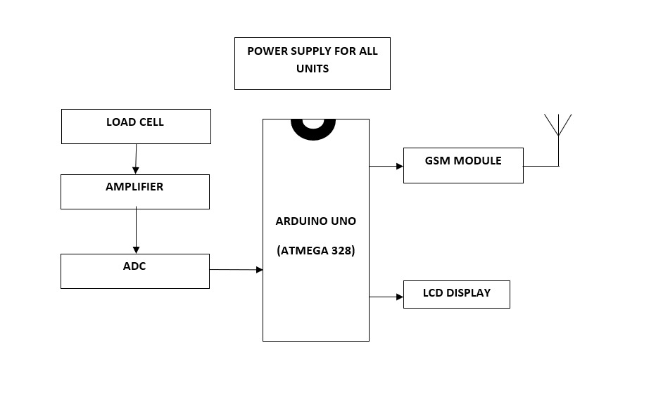
BLOCK DIAGRAM

Slide 9
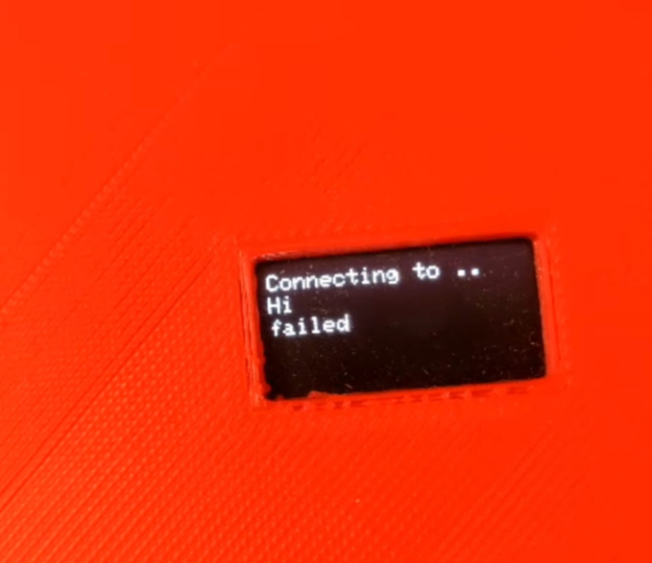
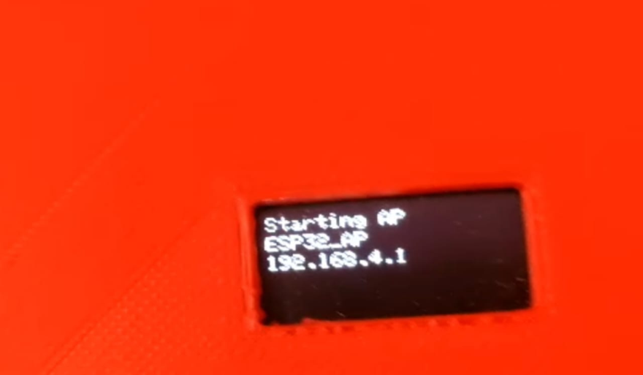
RESULT & DISCUSSION
When the cylinder weight falls below a pre-set threshold, the system automatically triggers an SMS to book a refill via the GSM module, ensuring uninterrupted LPG availability.

Slide 10
CONCLUSION &FUTURE WORK
In conclusion,successfully addresses the common challenges of LPG cylinder management in households. By automating the monitoring and refill booking process, the system ensures timely refills, reduces manual effort, and prevents disruptions in essential activities like cooking and heating.
When there is a leakage in gas cylinder the main supply in home is automatically cut off by using home automation.
Automatic payment should be paid after cylinder booking from user bank account.

Slide 11
GSM Module: Integrated into the system to send and receive SMS for booking requests and confirmations.
Microcontroller: Acts as the brain of the system, processing incoming requests and controlling the overall operation.
Database: Stores consumer details, booking history, and cylinder inventory data.
Mobile Application or SMS Service: Allows consumers to send booking requests via SMS or a dedicated
LPG Distributor Interface: A system for distributors to manage orders, track deliveries, and update the status of bookings.
Notification System: Sends SMS notifications to consumers about booking confirmations, delivery

Slide 12
ADVANTAGES
Convenience: Automates the monitoring and booking process, saving users from manually checking the LPG level and contacting the gas agency.
Timely Refills: Ensures refills are booked before the cylinder runs out, preventing cooking or heating disruptions.
User-Friendly: Simple design with a load cell, GSM module, and LCD display for easy understanding and interaction.

Slide 13
APPLICATION
Residential Households: Streamlines LPG management for families, ensuring they never run out of fuel unexpectedly.
Hostels and PGs: Helps managers efficiently monitor and refill LPG cylinders for large groups without manual intervention.
Small Businesses: Ideal for eateries, food trucks, and small-scale industries relying on LPG for daily operations.
Remote Areas: Reduces the challenges of accessing gas agencies, especially in rural or remote regions.

Slide 14
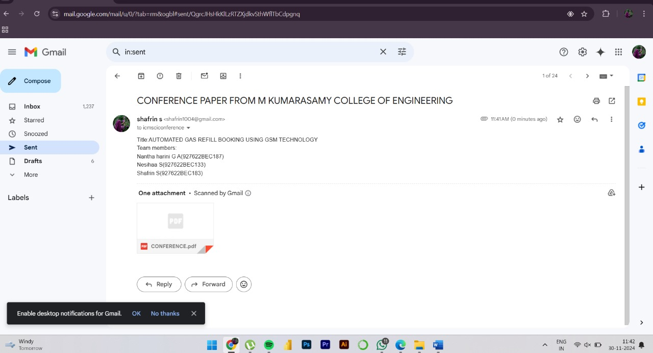
PROJECT OUTCOME

Slide 15
THANK YOU

